Slide 1
Web Scraping and EDA on Indeed.com
By Drace Zhan

Slide 2
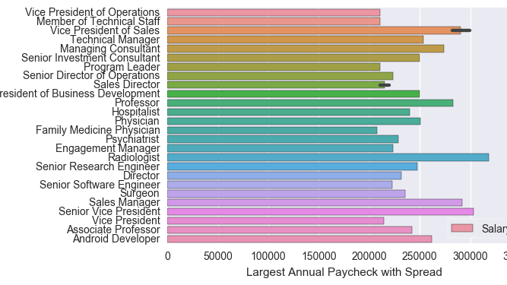
Which job listings pay best?
(I hope you want to be a radiologist…)

Slide 3
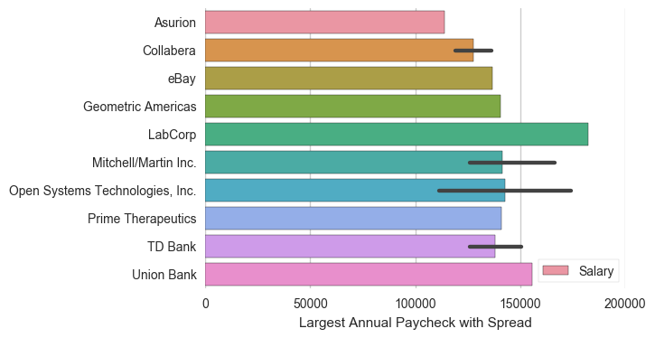
Companies that will pay you money
(Banks, tech, and internets)

Slide 4
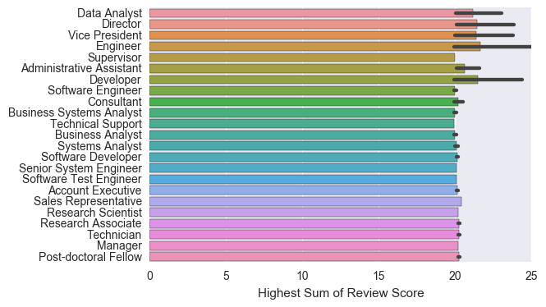

People who like their jobs
(nerds who tell people what to do)

Slide 5
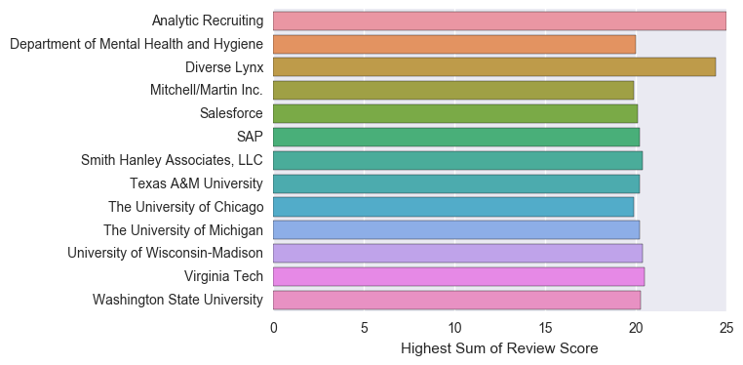

Places to Be
(Schools of not-so-hard knock)

Slide 6
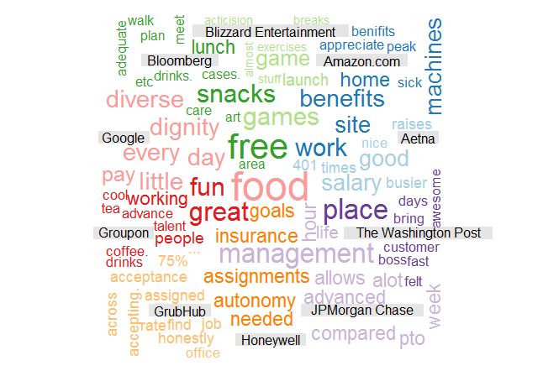
Wordcloud of What People Like

Slide 7
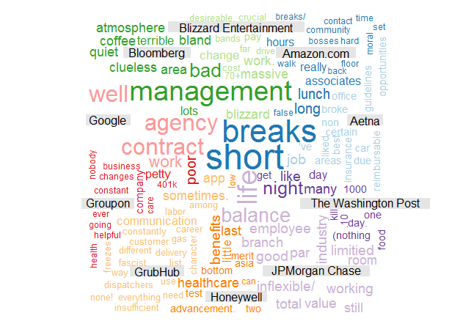
Wordcloud of What People Hate

Slide 8
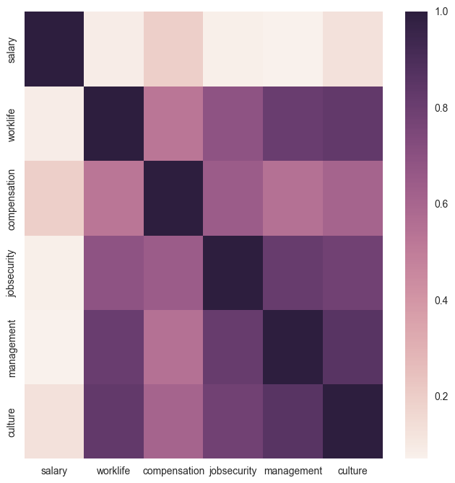
And now for some data modeling ...

Slide 9

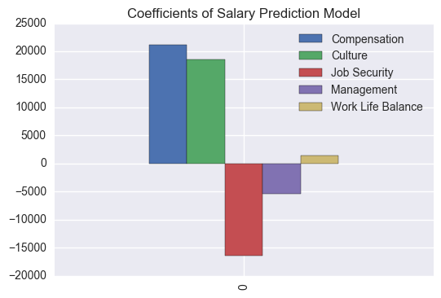
When Salary goes up ...
Job Security goes down

Slide 10
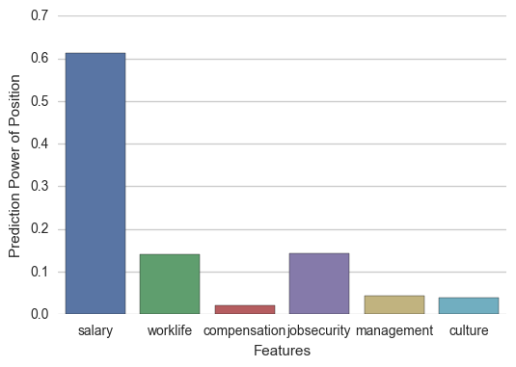
What gets the job?
(according to a random forest depth of three …)

Slide 11
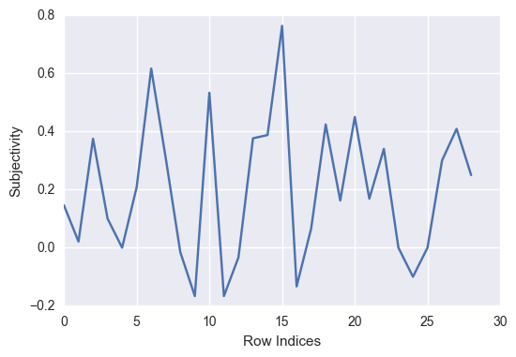
What People think about working at Washington Post
Subjective & Polarity through reviews via Textblob NLP

